Slide 1
Polymer
Lecture 1
University of diyala
Department of Physics
2021-12020

Slide 2
POLYMERS
Fundamentals of Polymer Technology
Thermoplastic Polymers
Thermosetting Polymers
Elastomers
Guide to the Processing of Polymers

Slide 3
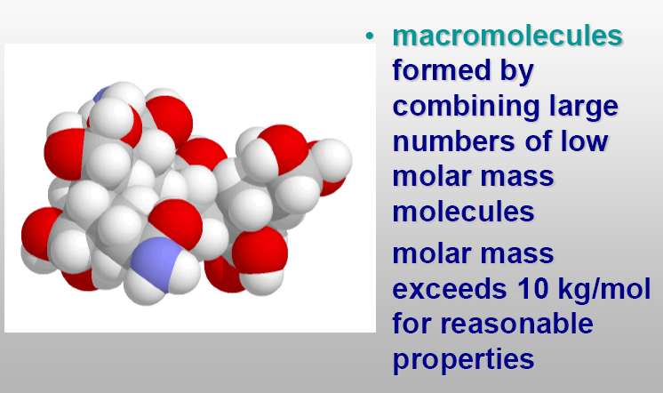

Slide 4
Polymer
A compound consisting of long‑chain molecules, each molecule made up of repeating units connected together (built up by repetitive bonding (covalent) of)
There may be thousands, even millions of units in a single polymer molecule
The word polymer is derived from the Greek words poly, meaning many, and meros (reduced to mer), meaning part
Most polymers are based on carbon and are therefore considered organic chemicals

Slide 5
Introduction To Polymer Chemistry
Polymer
A large molecule (macromolecule) built up by repetitive bonding (covalent) of
smaller molecules (monomers)
Polymers are formed by linking monomers through chemical reaction—called polymerization.
You don’t end up with a unique molecule.

Slide 6
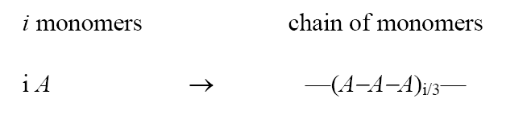
Polymers are formed by linking monomers through chemical reaction—called polymerization.
You don’t end up with a unique molecule.
Example

Slide 7
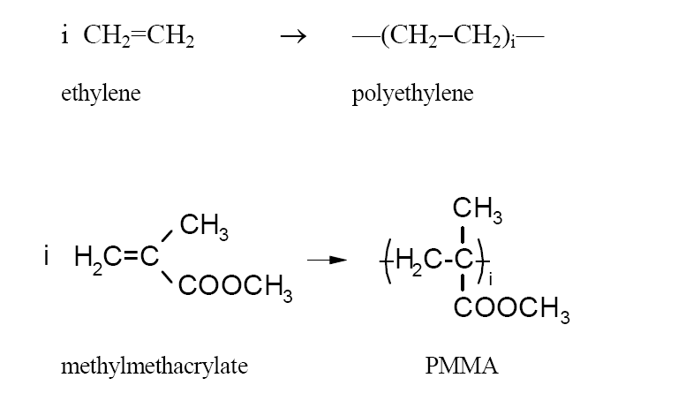
Homopolymer:
All monemer are A identical
· The most produced/used polymers are homopolymers of terminal alkenes.
· Produced by radical polymerization.

Slide 8
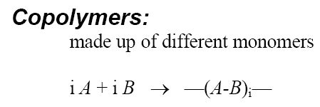
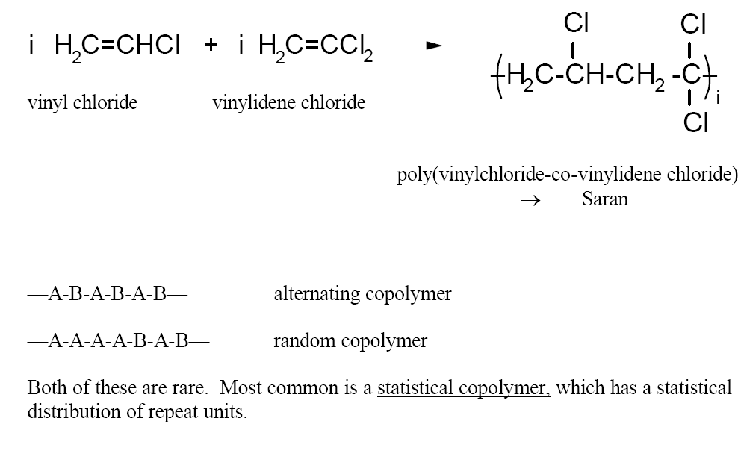

Slide 9
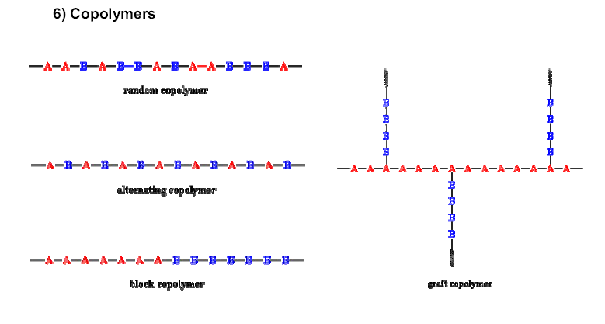

Slide 10


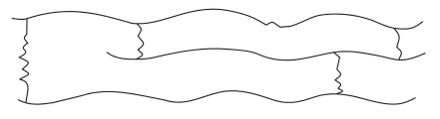
Structural characteristics - Closely related to material properties
Linear polymers are whose macromolecules are long chains with high degree of asymmetry
such as polythene, polyvinyl chloride, etc
Branched r polymer is a long chain ( usually called the main or backbone, chain) with side branches (side chain), the number of which may vary widely. such as low density polythene
Copolymer or three dimensional, polymer consistes of long chains connected up into a three dimentional network by chimecal crosslinks. such as bakelite, melamine

Slide 11
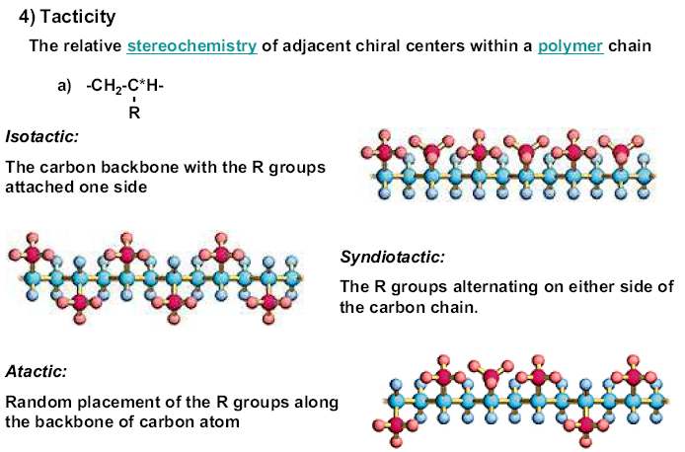

Slide 12
Classification of polymers:
Polymers (synthetic)
Thermoplastics (plastics) — linear, some cross-linking can be melted and reformed on heating - recyclable - crystalline or non-crystalline
a) Amorphous—no ordered structure
b) Semi-crystalline—composed of microscopic crystallites
domains of crystalline structure. Can be ordered. Fibers (nylon, polyester)
2) Elastomers (rubbers) — moderately cross-linked
can be stretched and rapidly recover their original dimension
3) Thermosets—(resins)—massively على نطاق واسع cross-linked
very rigid; degrade on heating - not recyclable
4) Dendrimers—multiply branched—multiple consecutive (regular) branches

Slide 13
Rubber and Elastomers
Rubber | Elastomers
butadiene, isoprene –cross linked structure –high strength –high recovery | –Thermoplastic –Thermoset –lightly cross linked –high elongation (>400%)

Slide 14
Biopolymers polypeptides—proteins-amino acid heteropolymer nucleic acids—RNA/DNA polysaccharides—sugars

Slide 15
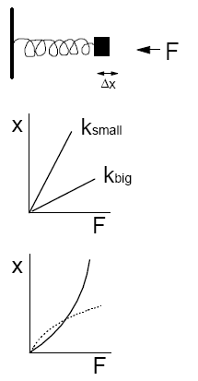
Characterization
1) How do polymers respond to an applied force?
(study of flow and deformation: rheology)
· An elastic medium is described by Newton’s Law:
F=-kx
·
If you apply a force (a stress), the material displaces by an amount x:
X = -F /k
small k: weak spring → easily displaced
big K: stiff spring → difficult to displace
· Polymers are often non-Newtonian

Slide 16
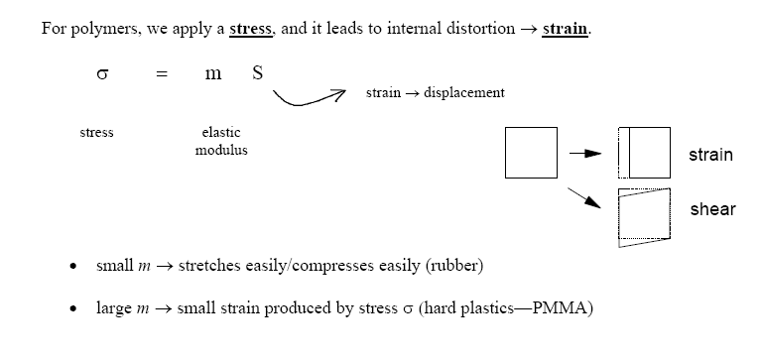

Slide 17
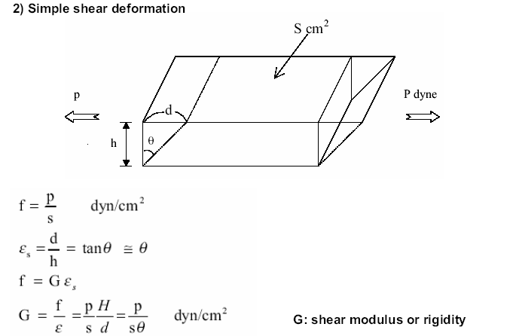

Slide 18
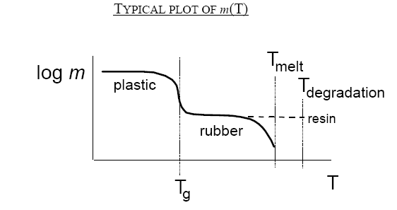
The elastic modulus m is highly temperature dependent!
Rubber has small m at room temperature.
Also, plastics heated above room temperature are less stiff.
Where m is room temperature on this plot?
(depends on whether you have a rubber or plastic)
The various temperatures characterize polymers.

Slide 19
2) Molecular Weight [Molar Mass (M )]
The number of repeating units or (monomer units) in the chain is called the degree of polymerization,denoted by the letter n or P.
The molar mass (molecular weight) of polymer molecule (M_{w}) equal to the degree of polymerization n and the moleculsr weight of monemeric unit M_{u}
M_{w} = n M_{u}
The degree of polymerization may be vary over a wide range , from a few units to 5000- 10000 and more.
Polymers with a high degree of polymerzation are called high polymer
Polymers with low degree of polymerization are known as oligomers
High polymers have M_{w}( 10⁴ -10⁶)
Oligomers have M_{w}( 5000-6000)

